Slide 1
Forecasting of FTSE 100 Index price movements using Quantum Computing approaches
TCS Quantum Challenge 4
Team Member : Aakash Swami (TCS Research)
Team Lead : Gajendra Malviya (TCS Research)
Team Number : 04360111

Slide 2

Problem statement
Accurate prediction of stock market trends and movements holds great significance in the financial industry as it enables investors, traders, and decision-makers to make informed choices and optimize their investment strategies.
Quantum computing is on the edge of technological boost and can show advantages in the accuracy.
We aim to predict the price of the FTSE 100 index based on historical data using the quantum approach and benchmark this against the classical approach.

Slide 3
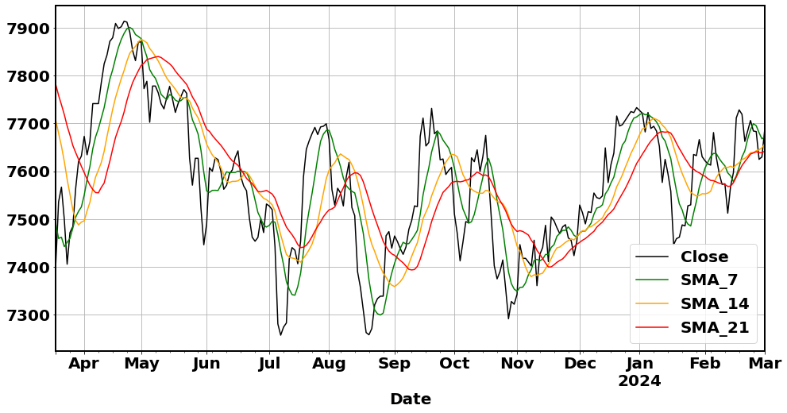
Data preparation
Data - Sep 2011 to 1st March 2024:​
Using exogenous features
Derived features and technical Indicators
Interpolation​
Data Normalization
Simple moving average
Exogenous features used:
GBP USD : High–low and Open-close
Gold price : High–low and Open-close
Crude futures : High–low and Open-close
Libor rate
Technical indicators​ used for FTSE close price
Moving averages (SMA) ​
Moving averages convergence divergences (MACD) ​
Exponential Moving Average (EMA)​
Bollinger bands

Slide 4
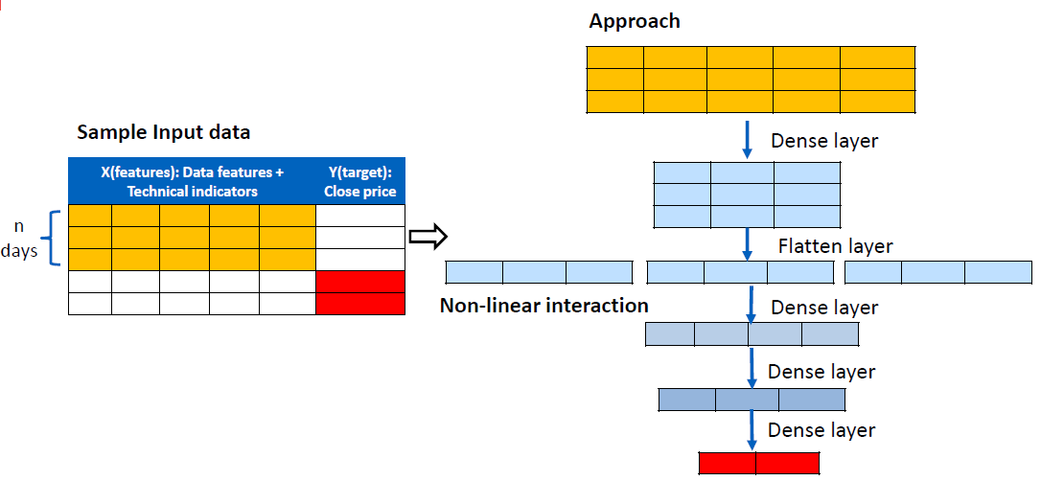
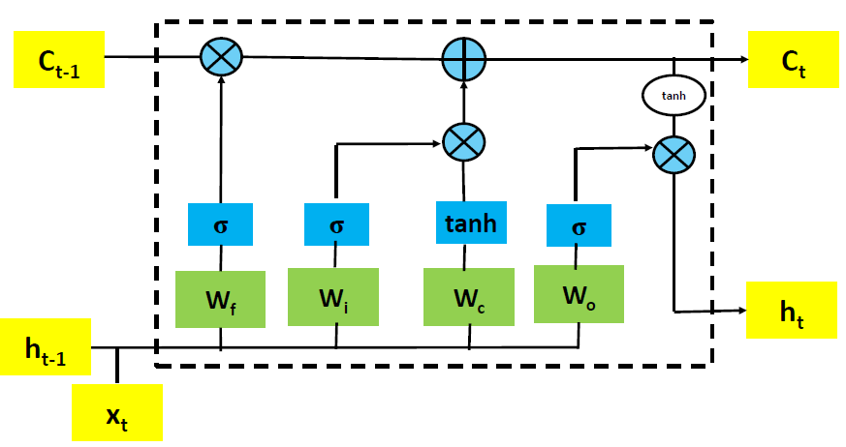
Classical approach
Machine learning XGBoost, ANN, MLR
Time series ARIMA, LSTM
Proposed a novel neural network-based approach called ‘Proposed-ANN’
LSTM and Proposed-ANN
Figure 1 : LSTM
Figure 2: Proposed ANN

Slide 5
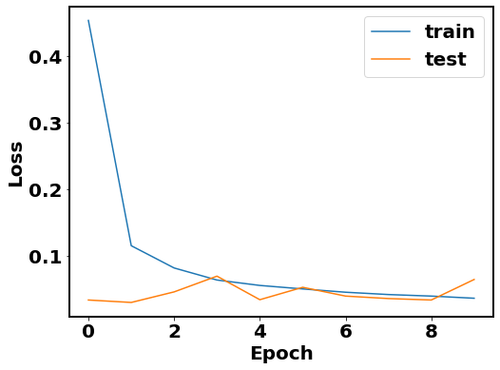
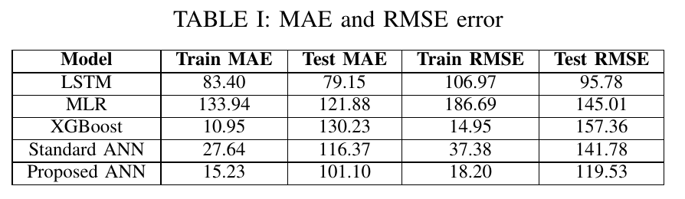
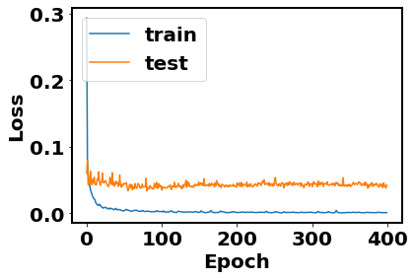
Result: Classical approach
96% of the data for training (3079 days) and 4% for testing(129 days).
Figure 3 : LSTM train and test loss curve
Few observations:
LSTM and Proposed ANN performed better than others
The test loss of LSTM is oscillating, and we perform an early epoch stop to avoid overfitting
The test loss of the proposed ANN is also oscillating but with less amplitude than that of LSTM
Figure 4 : Proposed-ANN train and test loss curve

Slide 6
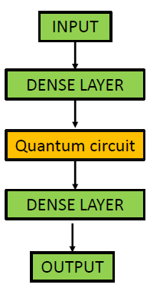
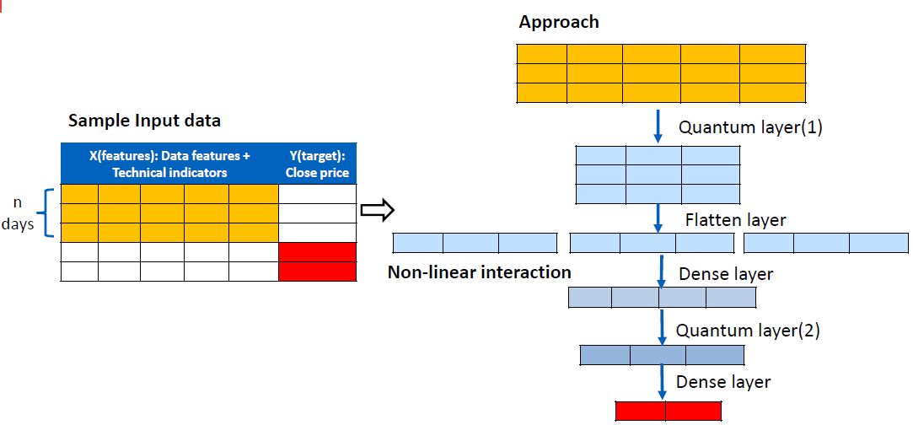
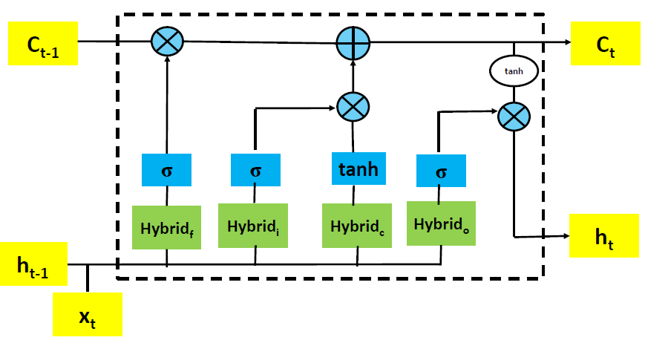
Quantum approach
Because we got best result with LSTM and proposed quantum-ANN, we explored quantum version of both
Quantum LSTM
Hybrid
Proposed Quantum Neural Network
Steps:
Pass ‘n’ days feature data through the Quantum layer(1). This generates the latent factors for each day.
Apply a flatten layer to the latent factors of the past ‘n’ days and place them in a sequence.
Bring the nonlinear interaction between these latent factors for the last ‘n’ days through a stack of dense and quantum layer(2) to predict the future
*Quantum Part

Slide 7
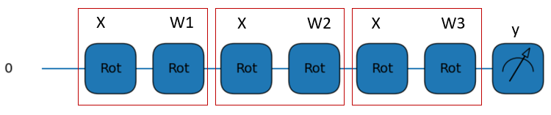
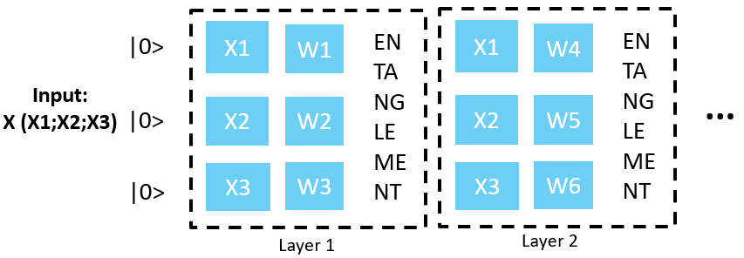
Multi-qubit data reuploading
Multi-qubit Data reuploading
Single qubit Data reuploading (DRC) [1]
L(i) = U(X)U(W)
Here U is arbitrary single-qubit rotations. If we incorporate data and processing angles in a single step, then, a layer will only need a single rotation to introduce data and tunable parameters.
L(i) = U( α_{i}+ w_{i} .X)
Figure 5 : Conceptual multi-qubit DRC
Here, each data point can be uploaded with some weight w_{i}. These weights will play a similar role as weights in artificial neural networks.
X
U(x₁,x₂,x₃) =RZ(x₃)RY(x₂)RZ(x₁)
Properties :
Enhance expressiveness of quantum circuit[2].
Increasing depth improve stability during training in noisy environment​ [3]
W
U(w₁,w₂,w₃) =RZ(w₃)RY(w₂)RZ(w₁)
Here U is arbitrary single-qubit rotations.

Slide 8
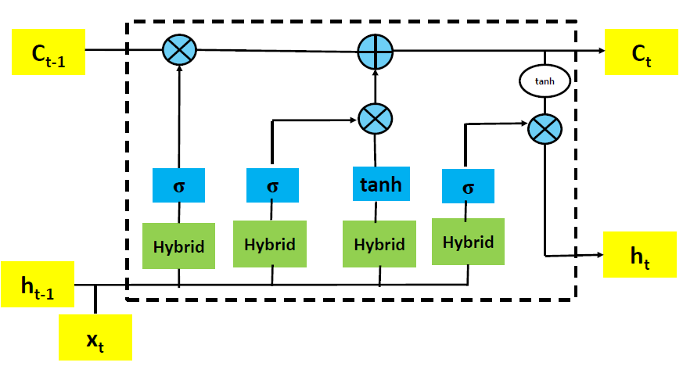
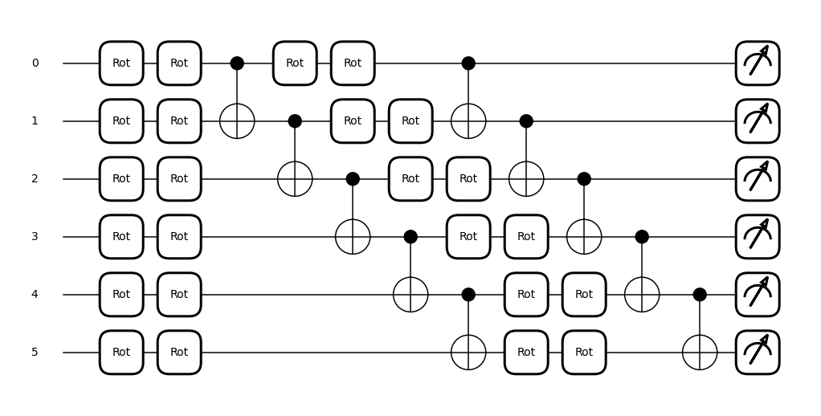
Quantum LSTM: quantum circuit
Hybrid
Quantum circuit:
Qubits: 6
Angle Encoding: Single qubit arbitrary rotation[4] to encode classical data
Ansatz: 2 layers multi-qubit data reuploading (DRC).
Measurement from all qubits is the expectation value of Pauli Z.
Figure 6 : Multi-qubit DRC quantum circuit

Slide 9
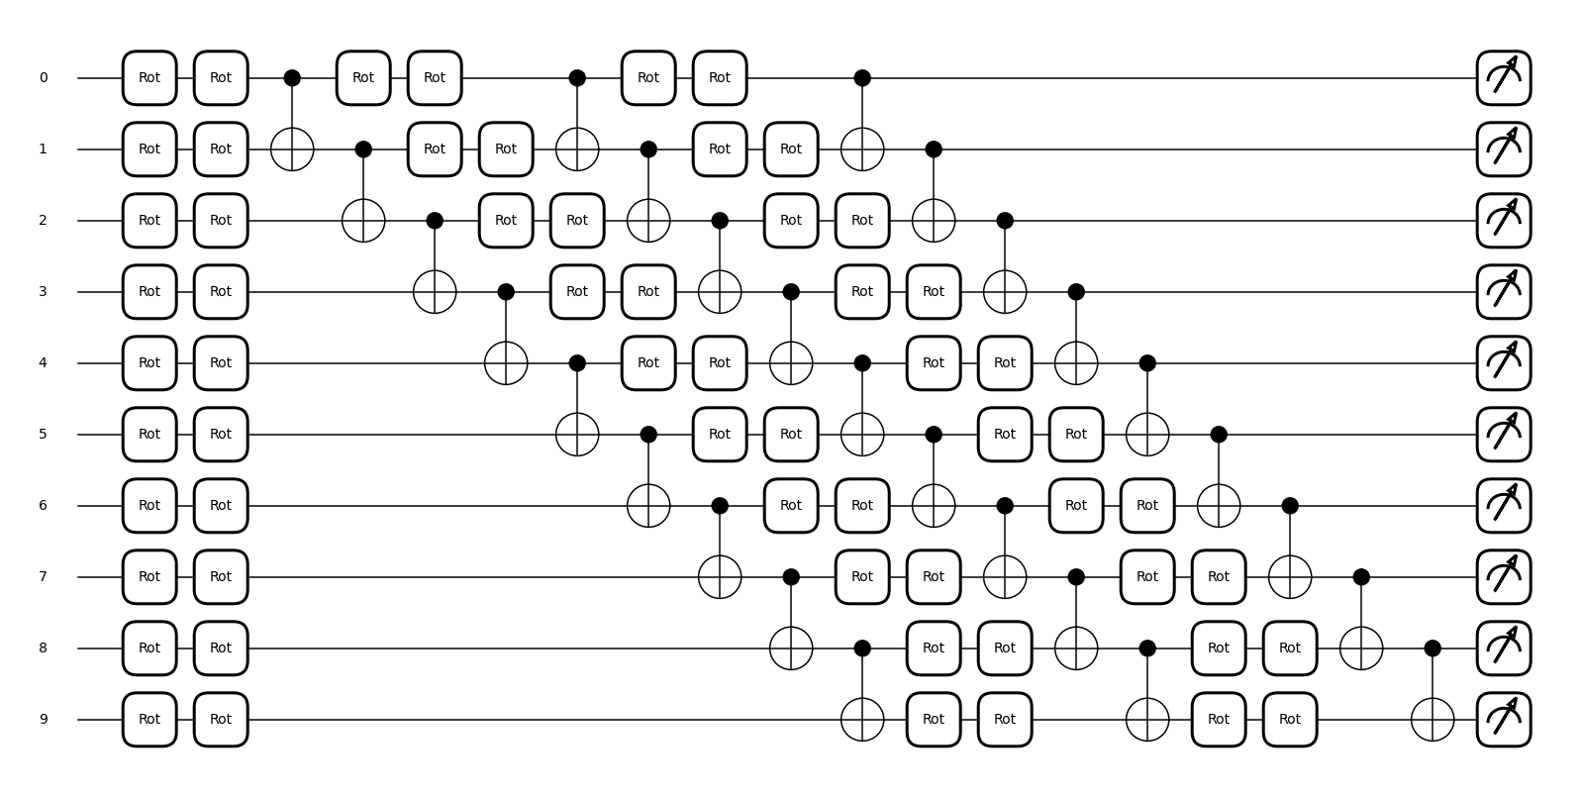
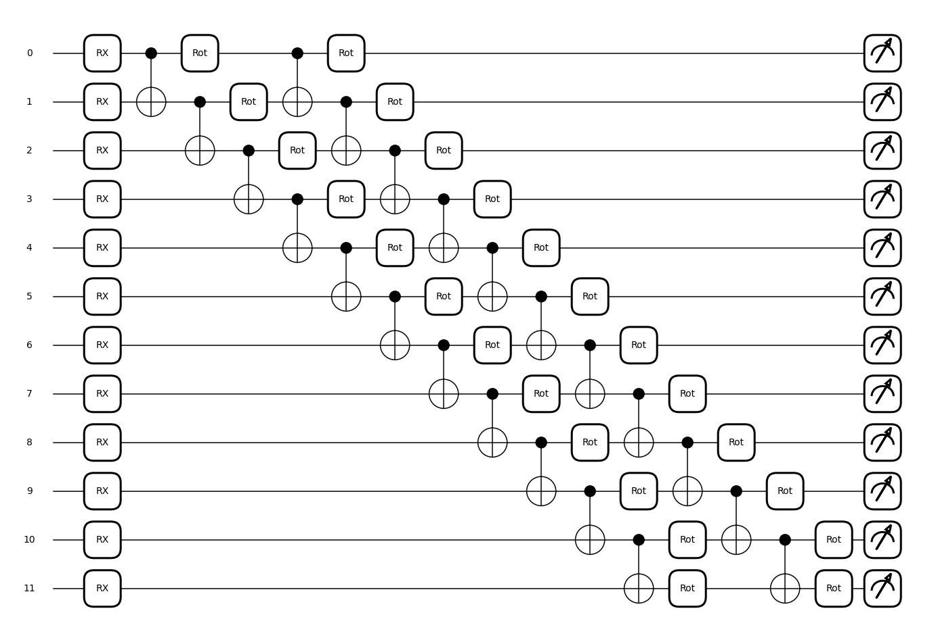
Proposed quantum neural network : quantum circuit
Quantum layer(1) (Figure 7):
Qubits: 10
Angle Encoding: Single qubit arbitrary rotation to encode data
Ansatz : 3 layers Multi-qubit DRC
Measurement from all qubits is the expectation value of Pauli Z.
Figure 7 : Quantum circuit (Quantum layer(1))
Quantum layer(2) (Figure 8):
Qubits: 12
Angle Encoding: Single qubit arbitrary rotation to encode data
Ansatz : Consists of layers of single qubit rotation U ∈ SU(2) and CX [5] entanglements.
Measurement from all qubits is the expectation value of Pauli Z.
Figure 8 : Quantum circuit (Quantum layer(2))

Slide 10
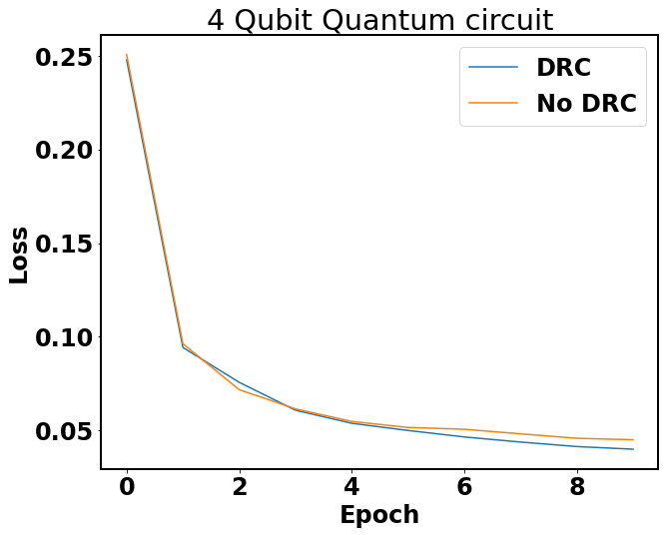
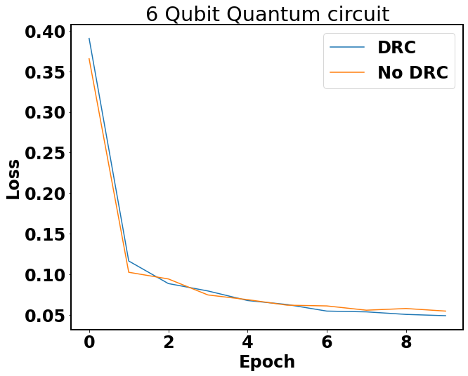
Result: Effect of data reuploading
Loss with DRC is less than NO-DRC
Loss with DRC is less than NO-DRC
Figure 9 : Training loss Quantum LSTM: 4 qubit quantum circuit
Figure 10: Training loss Quantum LSTM: 6 qubit quantum circuit
The effect of data reuploading is analyzed for both 4-qubit and 6-qubit quantum circuits.
The data reuploading concept helps in better learning as training loss decreases more for DRC than NO-DRC after a certain epoch.

Slide 11
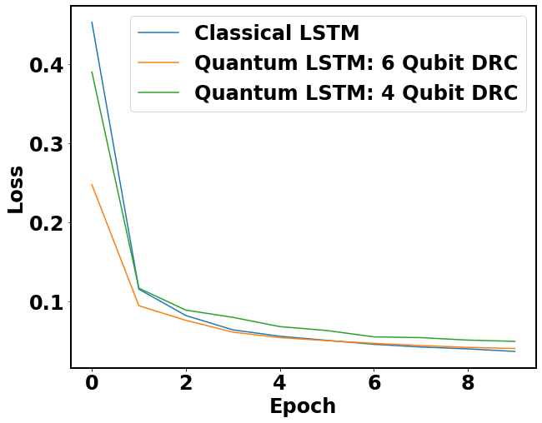
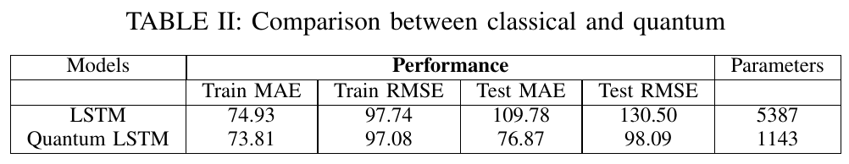
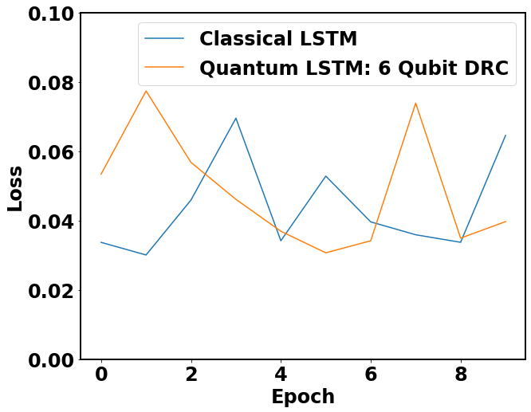
Result: Quantum LSTM
96% of the data for training(2647 days) and 4% for testing(111 days)
Used ‘default.qubit’ simulator from pennylane
Figure 11 : Quantum vs classical LSTM: training loss
Performance comparison:
6 qubits QLSTM can provide a comparable solution with classical LSTM.
Requires less computational parameters (1143 against 5387)
Improved performance with increase in number of qubits
The loss with quantum LSTM was less for same number of parameters
Figure 12 : Quantum vs classical LSTM: test loss
30-Apr-24

Slide 12
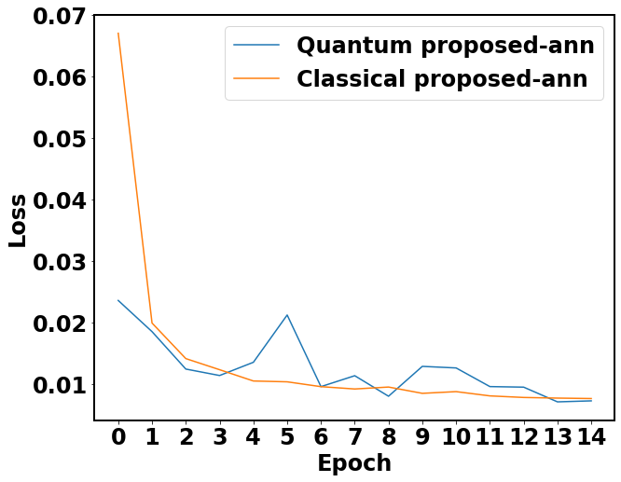
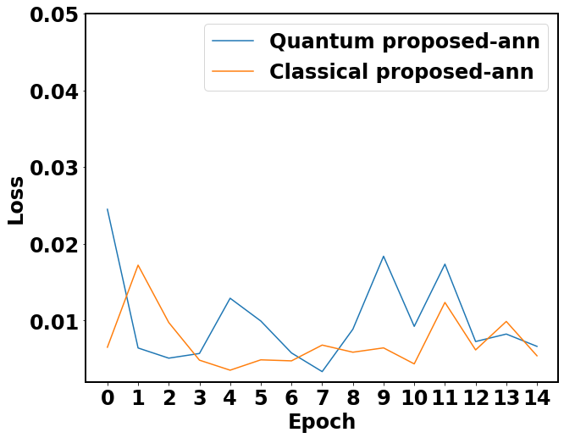
Result: Proposed Quantum Neural Network
96% of the data for training(2647 days) and 4% for testing(111 days)
Used ‘default.qubit’ simulator from pennylane
Initial error less for quantum
Models | Performance |  |  |  | Parameters
 | Train MAE | Train RMSE | Test MAE | Test RMSE
Proposed ANN | 88.03 | 104.84 | 92.37 | 100.28 | 3766
Proposed Quantum ANN | 97.63 | 107.87 | 104.39 | 110.72 | 1355
Figure 13 : Proposed Quantum vs classical NN training loss
Performance comparison:
Requires less computational parameters (1355 against 3766).
Learns more information in initial few epochs compared to classical approach
Comparable result to proposed quantum-ANN
The loss with quantum ANN was less for same number of parameters
Figure 14 : Proposed Quantum vs classical NN test loss

Slide 13
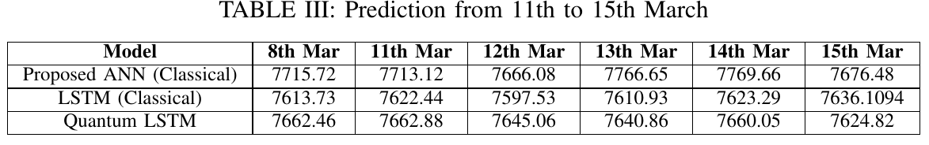
Final prediction
Proposed Quantum-ANN | 7701.74 | 7700.10 | 7708.77 | 7712.89 | 7688.78 | 7683.45
Actual | 7659.74 | 7669.23 | 7747.81 | 7772.17 | 7743.15 | 7731.63
Metric: Prediction from 11th to 15th March 2024
Model | MAE | RMSE | Predicted within Actual +/- 60
Proposed Quantum ANN | 46.34 | 47.47 | 1
Proposed ANN (Classical) | 42.55 | 49.76 | 0.8
Quantum LSTM | 86.05 | 96.07 | 0.2
LSTM(Classical) | 114.73 | 121.86 | 0.2

Slide 14
Way forward
Scalability of the approach
Scalable to the larger size problem by increasing the number of qubits.
Can be extended to predict for a greater number of days.
Larger 'sequence length’ can lead to improved accuracy
Performance can be improved using a quantum circuit with more qubits and depth.
Each of Quantum LSTM and Quantum proposed ANN can be enhanced as discussed below:
Replacing dense layer with a quantum layer wherever possible.
Using encoder that maps all qubit measurements to a single value at the output side.
Possible experiments:
Change in step size in time series, lower step size leads to more accurate results
Reduce oscillation in loss in LSTM and Quantum LSTM.
Run quantum approach for more epochs

Slide 15
Business Impact from Quantum
The performance of quantum approach with fewer learning parameters (Low qubit count and Low overall depth of circuits) shows its advantage in recognizing patterns in data or making predictions
Quantum approach learns more information in initial few epochs compared to classical approach
Quantum performance could improve with increasing quantum circuit depth and number of qubits.

Slide 16
Thank you

Slide 17
Appendix: Reference
[1] Pérez-Salinas, Adrián, Alba Cervera-Lierta, Elies Gil-Fuster, and José I. Latorre. "Data re-uploading for a universal quantum classifier." Quantum 4 (2020): 226
[2] S. Sim, P. D. Johnson, and A. Aspuru-Guzik, ``Expressibility and entangling capability of parameterized quantum circuits for hybrid quantum classical algorithms,'' Adv. Quantum Technol., vol. 2, no. 12, Dec. 2019, Art. no. 1900070, doi: 10.1002/qute.201900070.
[3] On Depth, Robustness and Performance Using the Data Re-Uploading Single-Qubit Classifier
[4] https://docs.pennylane.ai/en/stable/code/api/pennylane.Rot.html
[5] https://docs.quantum.ibm.com/api/qiskit/qiskit.circuit.library.EfficientSU2

Slide 18
Appendix: Features used
X : ['3M', 'BBB_20_2.0', 'BBL_20_2.0', 'BBM_20_2.0', 'BBP_20_2.0', 'BBU_20_2.0', 'Close_copy', 'Crude Futures_close', 'Crude Futures_volume', 'Crude_H-L', 'Crude_O-C', 'EMA_14', 'EMA_21', 'EMA_7', 'FTSE_H-L', 'FTSE_O-C', 'GBP USD ', 'GBP_USD_H-L', 'GBP_USD_O-C', 'Gold in USD close', 'Gold_H-L', 'Gold_O-C', 'MACD_12_26_9', 'MACDh_12_26_9', 'MACDs_12_26_9', 'SMA_14', 'SMA_21', 'SMA_7', 'Volume’]
Y: Close price

Slide 19
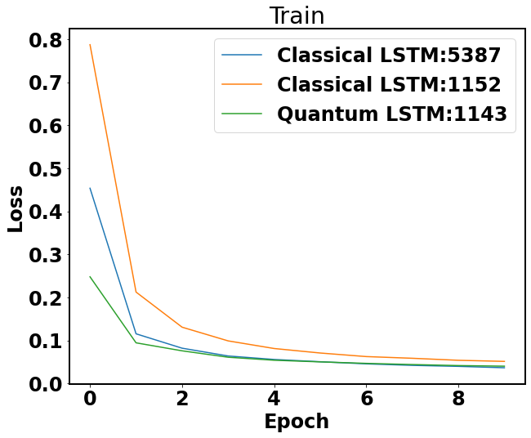
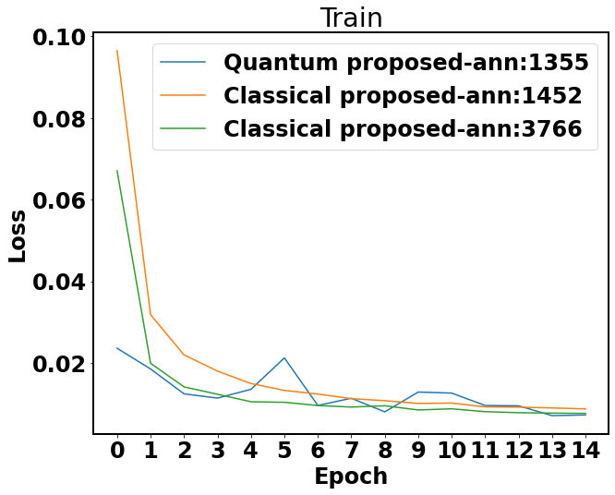
Appendix: Effect of number of parameters

Slide 20
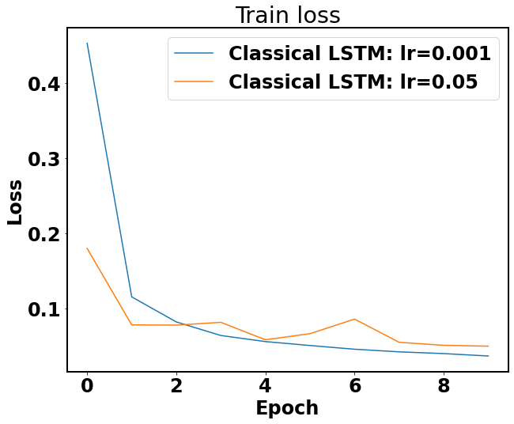
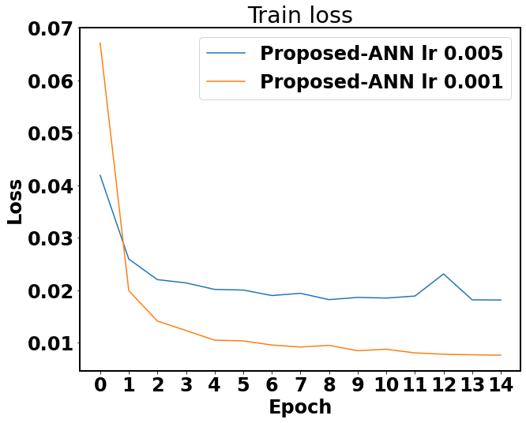
Appendix: Effect of learning rate
LSTM
Proposed-ANN

Slide 21
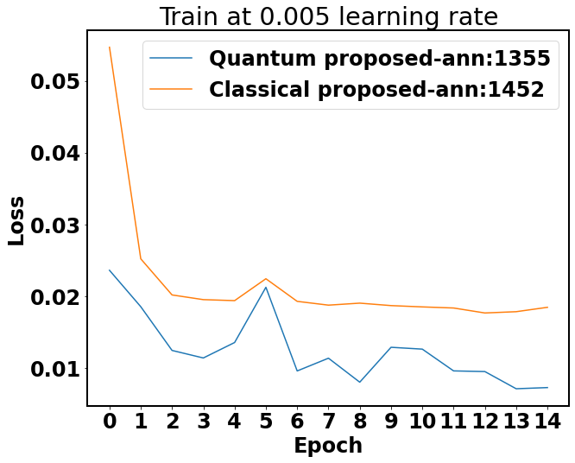
Appendix: Compare ANN: Learning rate 0.005

Slide 22
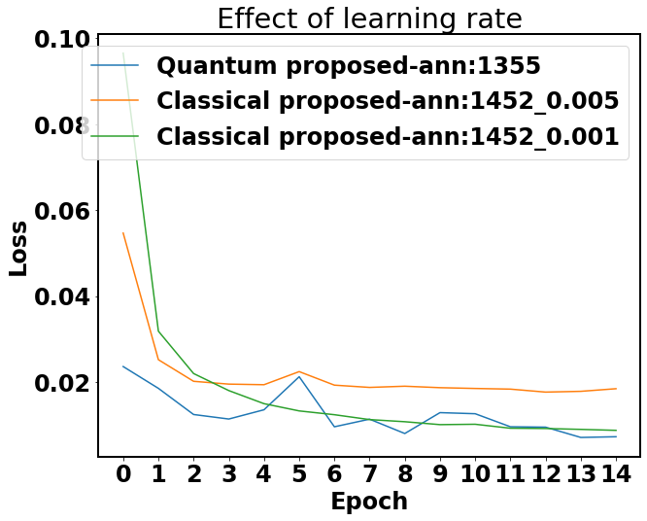
Appendix: Effect of learning rate

Slide 23
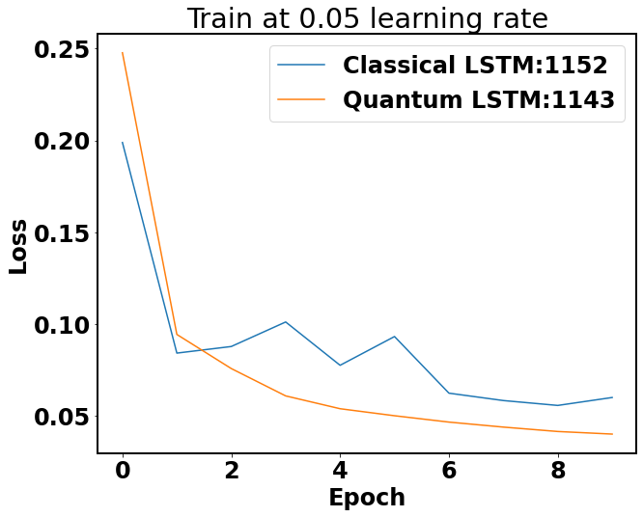
Appendix: Compare LSTM: Learning rate 0.05

Slide 24
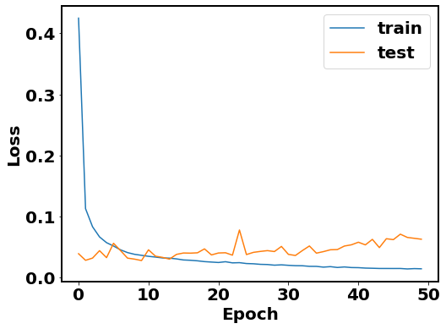
Appendix: LSTM overfitting

Slide 25
Appendix: Resource estimation
The number of tasks is scaled with epochs and step size.
Below table shows details on the number of tasks that need to be executed using the proposed quantum ANN approach:
The number of tasks using Aws sv1, and dm1 increases significantly if we code (Keras with Quantum ) or (Torch with Quantum). This might be because the gradient being calculated is based on an approach that requires a large number of tasks(needs to be explored more).
In a code where all learning parameters are inside quantum circuit, the aws sv1 and dm1 cost around $1.35 for 360 tasks.
Step size | Number of task
1 | 3140*60 + 1 = 188401
2 | 1570*60 + 1 =94201
3 | 1047*60 + 1 = 62821

Slide 26
Appendix: Classical approach configuration
LSTM: 2 layers ; Hidden unit: 16 ; Learning rate: 0.001
Standard ANN: Architecture 128->64->32->8->1; Activation function: PRelu() ; Learning rate: 0.001
ARIMA: p=0,q=1,d=0
Proposed-ANN : 20->Flatten layer->96->32->10

Slide 27
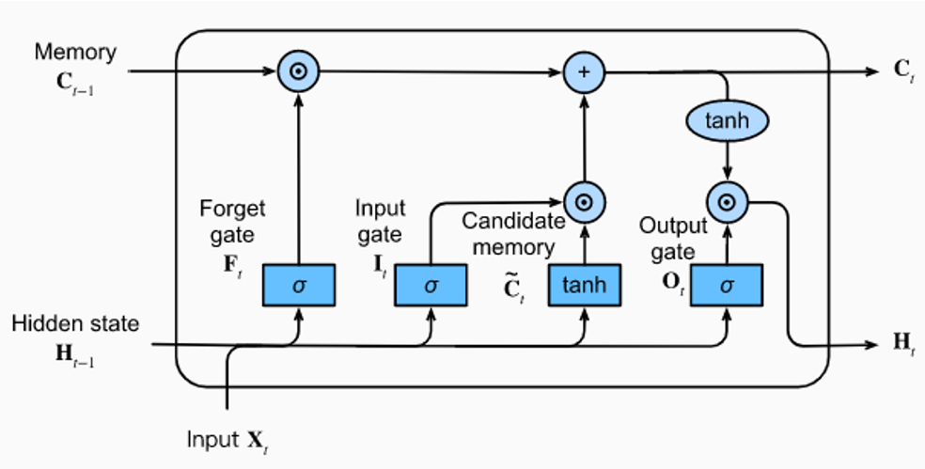
Appendix: LSTM properties
Properties:
LSTMs have three types of gates: input gates, forget gates, and output gates that control the flow of information.
The data feeding into the LSTM gates are the input at the current time step and the hidden state of the previous time step.
Three fully connected layers with sigmoid activation functions compute the values of the input, forget, and output gates.
All values of the three gates are in the range of (0,1).
The input node is typically computed with a tanh activation function. Intuitively, the input gate determines how much of the input node’s value should be added to the current memory cell’s internal state.
The forget gate determines whether to keep the current value of the memory or flush it.

Slide 28
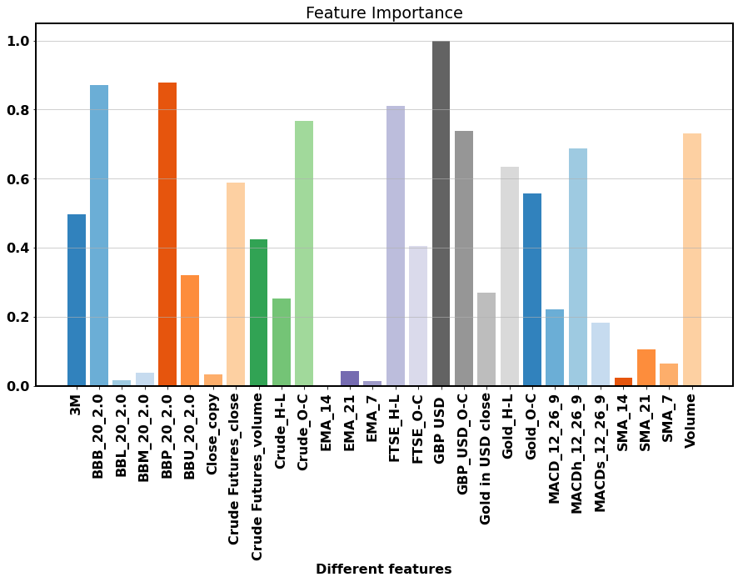
Appendix: Feature importance
The underlying principle used to calculate feature importance assumes that the more important a feature is, the more the weights connected to the respective input neuron will change during the training of the model. To capture this behavior, a running variance of every weight connected to the input layer is measured during training.
de Sá, Cláudio Rebelo. "Variance-based feature importance in neural networks." In International Conference on Discovery Science, pp. 306-315. Cham: Springer International Publishing, 2019.

Slide 29
Appendix: Step size
Sample 1
X(features): Technical indicators +other features |  |  |  |  | Y(target): Close price
Sequence length
Sample 2
X(features): Technical indicators +other features |  |  |  |  | Y(target): Close price
Step size
… Sample N

